Slide 1

Sample BSPH PowerPoint Using Starting Slide Layouts
Created by the Center for Teaching and Learning
May 2025

Slide 2
Section Title Slide

Slide 3
Drawing Attention with a Single Line of Text

Slide 4
Sometimes a Single Line is All We Need

Slide 5
An Abbreviated List of Active Learning Activities
Jigsaw method
Three-step interview
Round table
Mind mapping
Role play
Case study
Learn more about Active Learning on CTL Toolkit’s site.

Slide 6
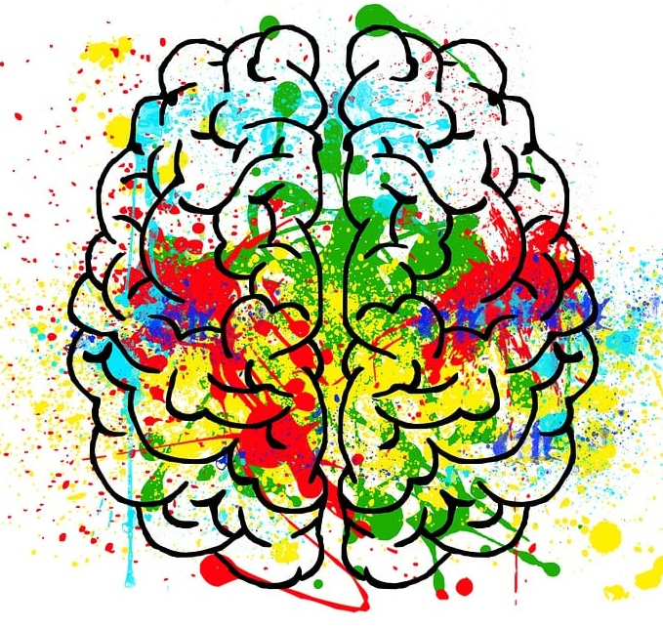
Universal Design for Learning (UDL)
Principles of UDL
The Framework’s Ultimate Goal is Learner Agency
Design Multiple Means of Engagement
Design Multiple Means of Representation
Design Multiple Means of Action and Expression
GOAL: “the capacity [for learners] to actively participate in making choices in service of learning goals.” (CAST 2024)
Learn more about UDL on CTL’s Teaching Toolkit site. CAST (2024). | Image by Elisa from Pixabay

Slide 7
The Engaged Learner Is…
One who is invested in their scholarship on a psychological level and makes the efforts to meet or exceed at the "knowledge, skills or crafts that [their] academic work is intended to promote.”
Lamborn, S., Newmann, F., & Wehlage, G. (1992). The significance and sources of student engagement. Student Engagement and Achievement in American Secondary Schools, 11-39.

Slide 8

Regarding Instructional Designers in Higher Education
In higher education, instructional designers are often seen as "change agents" because they help to facilitate behavioral changes and improve performance at their institutions. Due to their unique position of influence among higher education leaders and faculty and their use of systems thinking, instructional designers can help bridge institutional priorities and the specific needs of various stakeholders.
Bond, Aaron, et al. “Instructional Designers as Institutional Change Agents.” EDUCAUSE Review, 31 Oct. 2023, er.educause.edu/articles/2023/10/instructional-designers-as-institutional-change-agents.
Microsoft Stock Imagery.

Slide 9



Higher Orders of Bloom’s Taxonomy
Analyzing
Breaking material into constituent parts and investigating relationships
Evaluating
Making judgements based upon standards and criteria
Creating
Putting elements together to construct a novel and coherent whole
Barrett, Tom. (2023, February 6). Uplevel your prompt craft in ChatGPT with the CREATE framework. https://edte.ch/blog/create-framework/?v=3a1ed7090bfa Microsoft Stock Imagery

Slide 10






Lookback: Public Health Threat Responses by the CDC (U.S.)
A selection from the Centers for Disease Control and Prevention (CDC) Epidemic Intelligence Service records.
1955: Polio eradication initiation
1981: HIV/AIDS first reported
2003: SARS
1976: Legionnaires’ Disease
1993: E. coli
2016: Zika
Centers for Disease Control and Prevention (U.S.). Epidemic Intelligence Service. (2018). A History of success : investigating and responding to public health threats since 1951 : milestone investigations.

Slide 11

CTL Builds and Maintains CoursePlus
A Proprietary Learning Management System Meeting the Unique Needs of BSPH Academics
Learn more about CoursePlus on our Teaching Toolkit site.

Slide 12
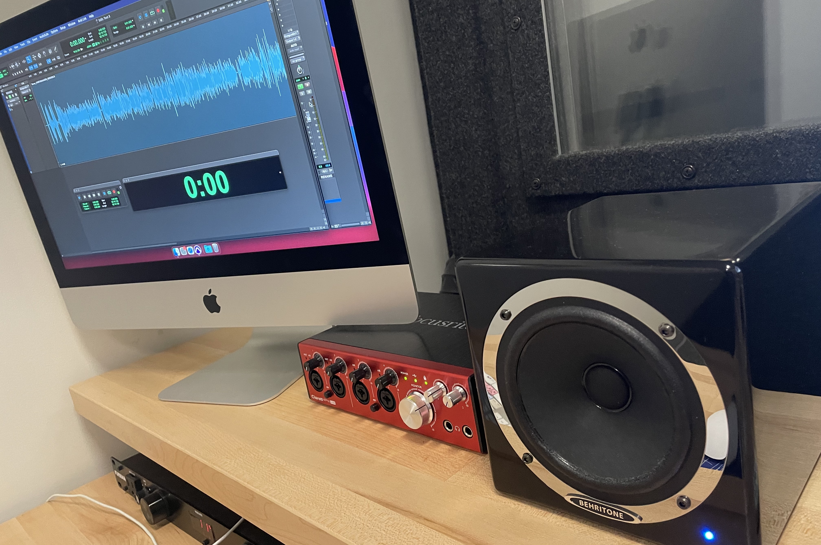

CTL Offers Professional Recording
Audio Recording
Video Recording
Both Audio and Video
CTL Image of audio studio. Video photo by Jaël Vallée on Unsplash Learn more about recording with CTL on our Toolkit page.

Slide 13
CTL is Here to Help
The Center for Teaching and Learning team is dedicated to applying evidence-based methods and professionally produced tools to help instructors create a rich and inspiring learning environment.
Our instructional designers, web developers, technical writers, medical illustrators, and audio and video specialists collaborate with subject-matter experts to produce state-of-the-art academic and training courses as well as open educational resources on health-related topics. They equip our faculty with the latest tools and best practices for student engagement, accessibility, learning assessment, and course management—for both online and on-campus learning.
Services Overview
https://publichealth.jhu.edu/offices-and-services/center-for-teaching-and-learning

Slide 14
About This Presentation
© Copyright 2025 Johns Hopkins University.
Produced by the Center for Teaching and Learning at the Johns Hopkins Bloomberg School of Public Health.
The material in this video is subject to the copyright of the owners of the material and is being provided for educational purposes under rules of fair use/copyright law for registered students in this course only. No additional copies of the copyrighted work may be made or distributed.
S2504A2504

