Slide 1
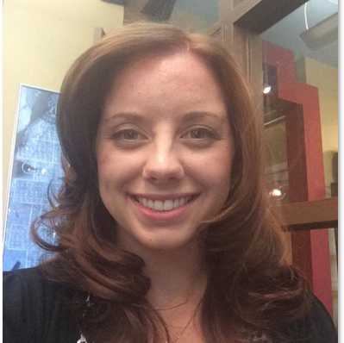
Giving Students Effective Feedback
Amy Pinkerton
Senior Instructional Designer
BSPH Center for Teaching and Learning (CTL)
February 2024

Slide 2
Objectives
Explain the instructional purpose of feedback
Identify the characteristics of effective feedback
Communicate effective feedback to your students
Discuss strategies for managing feedback (e.g., time-saving tips, etc.)

Slide 3



Defining Feedback
Verbal
Written
Gestural
University of South Carolina Center for Teaching Excellence. (n.d.). Importance of Providing Meaningful Student Feedback. https://sc.edu/about/offices_and_divisions/cte/teaching_resources/grading_assessment_toolbox/providing_meaningful_student_feedback/index.php#:~:text=Feedback%20is%20any%20response%20regarding,put%20a%20damper%20on%20it.

Slide 4
Feedback vs Praise
Hattie, J., & Timperley, H. (2007). The Power of feedback. Review of Educational Research, 77(1), 81–112. https://doi.org/10.3102/003465430298487

Slide 5

Purpose
Photo by Markus Spiske on Unsplash

Slide 6

Feedback as Part of the Learning Process
Guides Learners towards Accomplishment
Helps Sustain Motivation
Universal Design for Learning Strategy Database: Increase mastery-oriented feedback (Checkpoint 8.4). (n.d.). Relay Graduate School of Education Library. https://relay.libguides.com/udl-strategy-database/sustaining-effort#s-lg-box-26743854
University of South Carolina Center for Teaching Excellence. (n.d.). Importance of Providing Meaningful Student Feedback. https://sc.edu/about/offices_and_divisions/cte/teaching_resources/grading_assessment_toolbox/providing_meaningful_student_feedback/index.php#:~:text=Feedback%20is%20any%20response%20regarding,put%20a%20damper%20on%20it.

Slide 7
Student Perspective - 1
WHAT am I understanding or not understanding?
WHERE is my performance going well or poorly?
Ambrose, S. A., Bridges, M. W., DiPietro, M., Lovett, M. C., & Norman, M. K. (2010). How learning works: Seven research-based principles for smart teaching. Jossey-Bass.

Slide 8
Student Perspective - 2
HOW should I direct my subsequent efforts?
WHY is this relevant?
Ambrose, S. A., Bridges, M. W., DiPietro, M., Lovett, M. C., & Norman, M. K. (2010). How learning works: Seven research-based principles for smart teaching. Jossey-Bass.

Slide 9
Questions? - 1

Slide 10
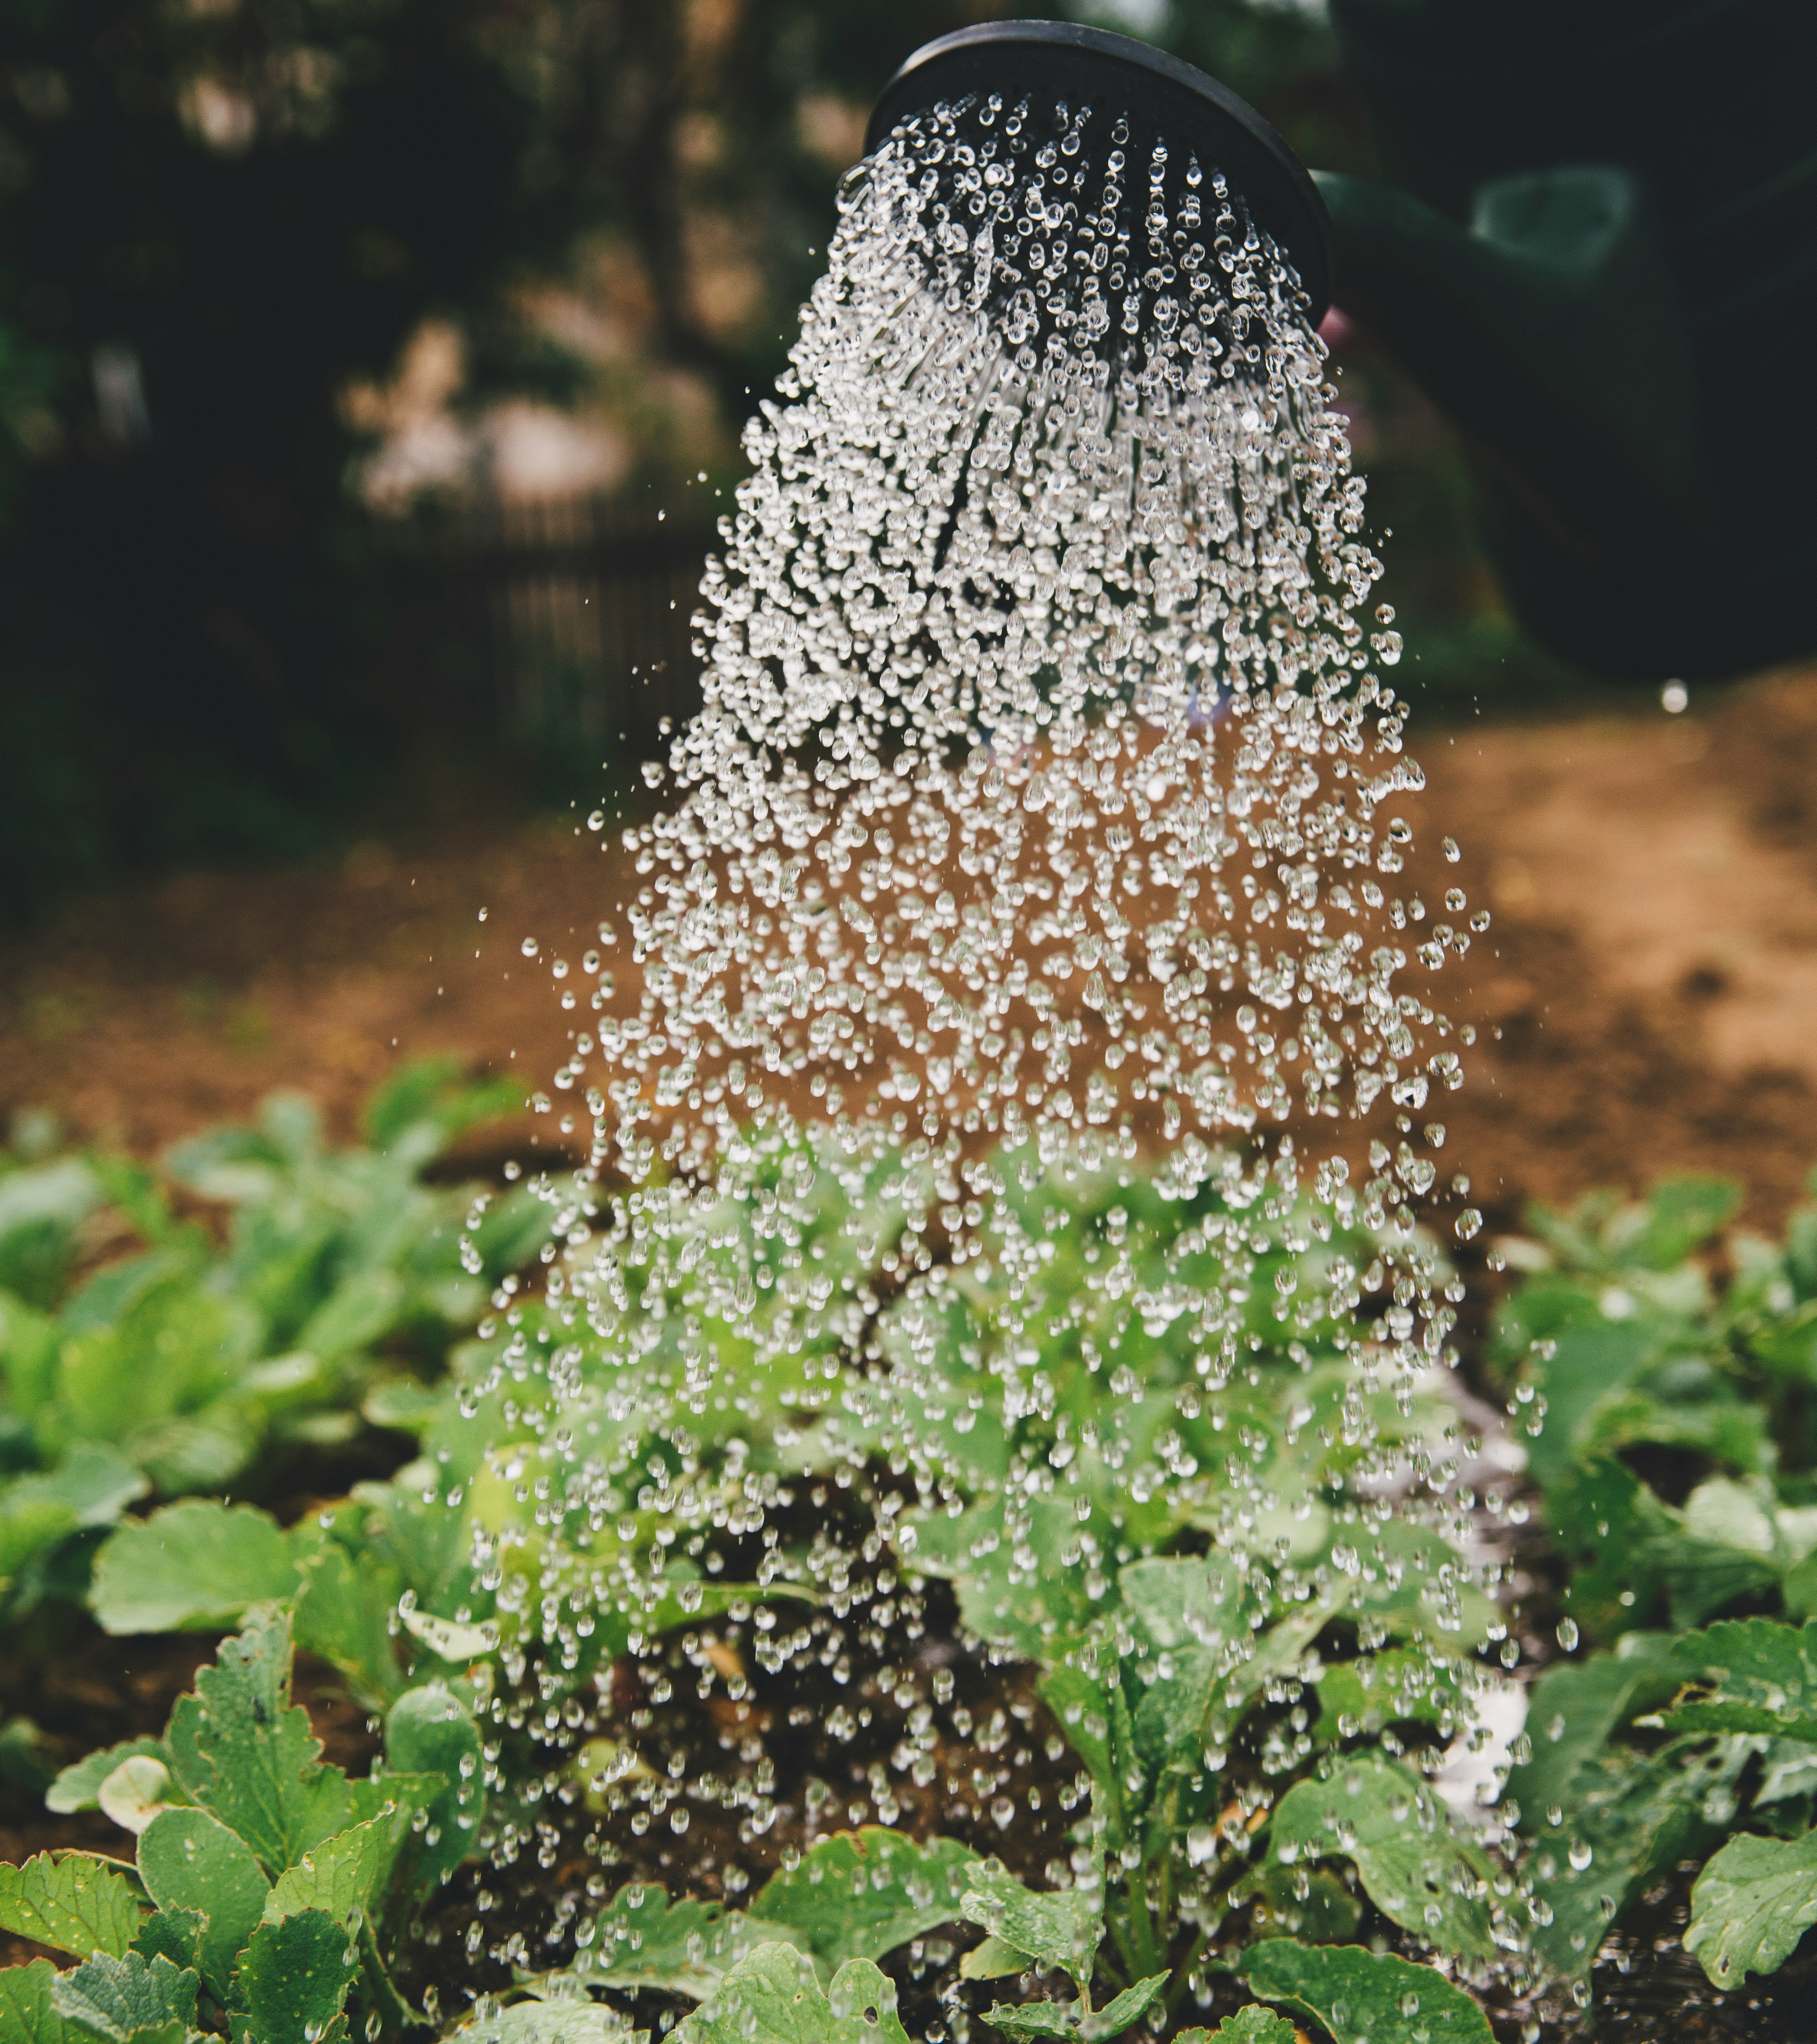
Characteristics
Photo by Markus Spiske on Unsplash

Slide 11




Characteristics of Effective Feedback
Specificity
Timeliness
Focus
Intentionality
Pinkerton, A. (n.d.). Providing Feedback [online course resource page]. In Essentials of Course Design, Development, and Teaching at BSPH. Johns Hopkins Bloomberg School of Public Health Center for Teaching and Learning. https://courseplus.jhu.edu/core/index.cfm/go/pb:page.view/coID/19855/pageID/130435/-

Slide 12
Unclear is Unkind

Slide 13
Focus on the Performance, Not the Person
“You did not explain concept ABC clearly enough to make this argument.”
“Concept ABC is unclear here. The argument in this paragraph would be stronger if it further explained why concept ABC.”

Slide 14

Prioritize Your Feedback

Slide 15

Check the Distribution

Slide 16
Questions? - 2

Slide 17
Communicate
Photo by Lawrence Aritao on Unsplash

Slide 18
Activity: Writing Effective Feedback

Slide 19
Instructions
1
2
3
Download the Giving Students Effective Feedback Checklist document from the Zoom Chat.
We will look at each example together.
You will have 2 minutes to re-write each example feedback within the worksheet.
When the timer goes off, 2-3 volunteers may share what they wrote.
The workshop facilitator will share what they wrote for each example and explain why.

Slide 20
Example 1
Context
Feedback
Student A received full marks for their presentation.
The objective was to demonstrate a synthesis of ideas, conduct an in-depth analysis, and provide evidence for the topic.
Good work on the presentation!

Slide 21
Example 1 – My Rewrite
Original
Rewrite
Explanation
Good work on the presentation!
Good work! Overall, the presentation showed a synthesis of ideas, in-depth analysis, and evidence for the topic.
Specificity
Focus

Slide 22
Example 2
Context
Feedback
Student B received partial credit for their recorded draft.
The objective was to communicate a well-researched argument by demonstrating a strong understanding of issues and synthesis of ideas using supporting evidence.
Overall, you supported your stance with some supporting evidence and seem to understand topic XXX. Some parts were unclear and could be stronger.

Slide 23
Example 2 – My Rewrite
Original
Rewrite
Explanation
Overall, you supported your stance with some supporting evidence and seem to understand topic XXX. Some parts were unclear and could be stronger.
Overall, the draft contains some supporting evidence and indicates a decent understanding of the topic. For the final draft, please expand on topic XXX with further research. To make the argument more convincing, consider reorganizing the evidence to begin and end with your strongest points, then scatter the weaker arguments throughout.
Impersonal
Specificity
Focus

Slide 24
Example 3
Context
Feedback
Student C only submitted a few sentences on the assignment topic and has been asked to redo their work.
The objective was to correctly identify variables relevant to primary stakeholders and how these may create tensions or conflicts of interest among different stakeholders.
You did not complete the assignment prompt. Please redo the assignment by [DATE].

Slide 25
Example 3 – My Rewrite
Original
Rewrite
Explanation
You did not complete the assignment prompt. Please redo the assignment by [DATE].
The presentation shows some general understanding of the variables relevant to stakeholders but does not provide any analysis. The goal of this assignment was to identify variables that are relevant to primary stakeholders and how these may create tensions or conflicts of interest among different stakeholders. Please sign up for Office Hours by [DATE] so we can discuss options for redoing this assignment.
Impersonal
Specific
Focus
Next Steps

Slide 26
Questions? - 3

Slide 27

Strategies
Photo by Jonathan Kemper on Unsplash

Slide 28

Incorporating Feedback into a 3-Credit Course
Mia Lamm
Sr. Instructional Designer | Center for Teaching and Learning
Associate Faculty | Health, Policy, and Management

Slide 29




Strategies for Feedback
Focused Comments
Early Opportunities
Editorial
Ask Questions
University of South Carolina Center for Teaching Excellence. (n.d.). Importance of Providing Meaningful Student Feedback. https://sc.edu/about/offices_and_divisions/cte/teaching_resources/grading_assessment_toolbox/providing_meaningful_student_feedback/index.php#:~:text=Feedback%20is%20any%20response%20regarding,put%20a%20damper%20on%20it.

Slide 30




Time-Saving Tips
Rubrics
Consolidate
Comment Bank
Sort Assignments
Pinkerton, A. (n.d.). Providing Feedback [online course resource page]. In Essentials of Course Design, Development, and Teaching at BSPH. Johns Hopkins Bloomberg School of Public Health Center for Teaching and Learning. https://courseplus.jhu.edu/core/index.cfm/go/pb:page.view/coID/19855/pageID/130435/

Slide 31




Explore Other Feedback Methods
Verbal, in-person
Verbal, recorded
Written
Gestural
University of South Carolina Center for Teaching Excellence. (n.d.). Importance of Providing Meaningful Student Feedback. https://sc.edu/about/offices_and_divisions/cte/teaching_resources/grading_assessment_toolbox/providing_meaningful_student_feedback/index.php#:~:text=Feedback%20is%20any%20response%20regarding,put%20a%20damper%20on%20it.
Brewer, N. & Laist, R. (2023). Making Feedback Meaningful: UDL-Based Solutions for Responding to Student Writing. The Teaching Professor. https://www.teachingprofessor.com/topics/grading-feedback/feedback/making-feedback-meaningful-udl-based-solutions-for-responding-to-student-writing/

Slide 32
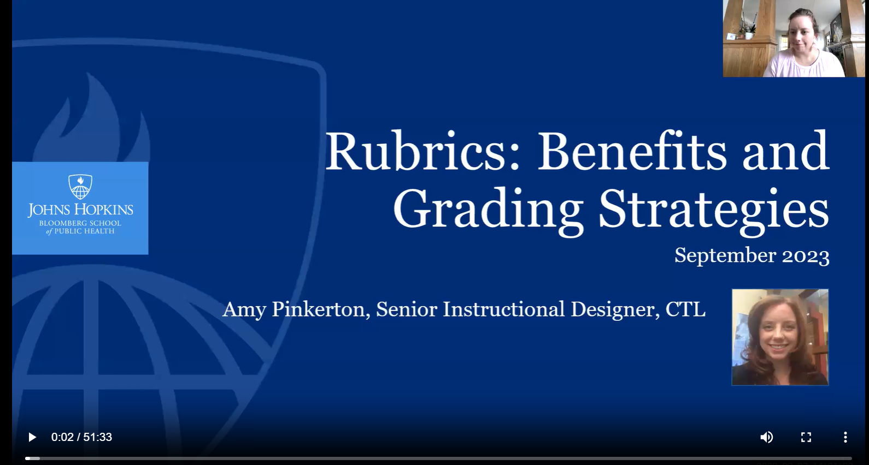
Dive Deeper!
CTL On-Demand Workshop Videos: https://www.ctltoolkit.com/on-demand-workshop-videos
Rubrics: Benefits and Grading Strategies (September 2023)
  Rubrics are grading tools that save time, increase grading consistency, and help deliver effective feedback to students. In this virtual workshop, attendees learned about rubrics' benefits and how to design rubrics based on their assessment needs.

Slide 33

Conclusion
Photo by Florian GIORGIO on Unsplash

Slide 34
References
Ambrose, S. A., Bridges, M. W., DiPietro, M., Lovett, M. C., & Norman, M. K. (2010). How learning works: Seven research-based principles for smart teaching. Jossey-Bass.
Brewer, N. & Laist, R. (2023). Making Feedback Meaningful: UDL-Based Solutions for Responding to Student Writing. The Teaching Professor. https://www.teachingprofessor.com/topics/grading-feedback/feedback/making-feedback-meaningful-udl-based-solutions-for-responding-to-student-writing/
Hattie, J., & Timperley, H. (2007). The Power of feedback. Review of Educational Research, 77(1), 81–112. https://doi.org/10.3102/003465430298487
Pinkerton, A. (n.d.). Providing Feedback [online course resource page]. In Essentials of Course Design, Development, and Teaching at BSPH. Johns Hopkins Bloomberg School of Public Health Center for Teaching and Learning. https://courseplus.jhu.edu/core/index.cfm/go/pb:page.view/coID/19855/pageID/130435/-
Universal Design for Learning Strategy Database: Increase mastery-oriented feedback (Checkpoint 8.4). (n.d.). Relay Graduate School of Education Library. https://relay.libguides.com/udl-strategy-database/sustaining-effort#s-lg-box-26743854
University of South Carolina Center for Teaching Excellence. (n.d.). Importance of Providing Meaningful Student Feedback. https://sc.edu/about/offices_and_divisions/cte/teaching_resources/grading_assessment_toolbox/providing_meaningful_student_feedback/index.php#:~:text=Feedback%20is%20any%20response%20regarding,put%20a%20damper%20on%20it.

Slide 35

Professional Development Opportunities
Essentials of Course Design, Development & Teaching at BSPH
Teaching Assistantship Training Course
Workshops and On-Demand Workshop Videos
CTL Blog
CTL Teaching Toolkit Website
https://www.ctltoolkit.com/teachingandlearning/professional-development

Slide 36
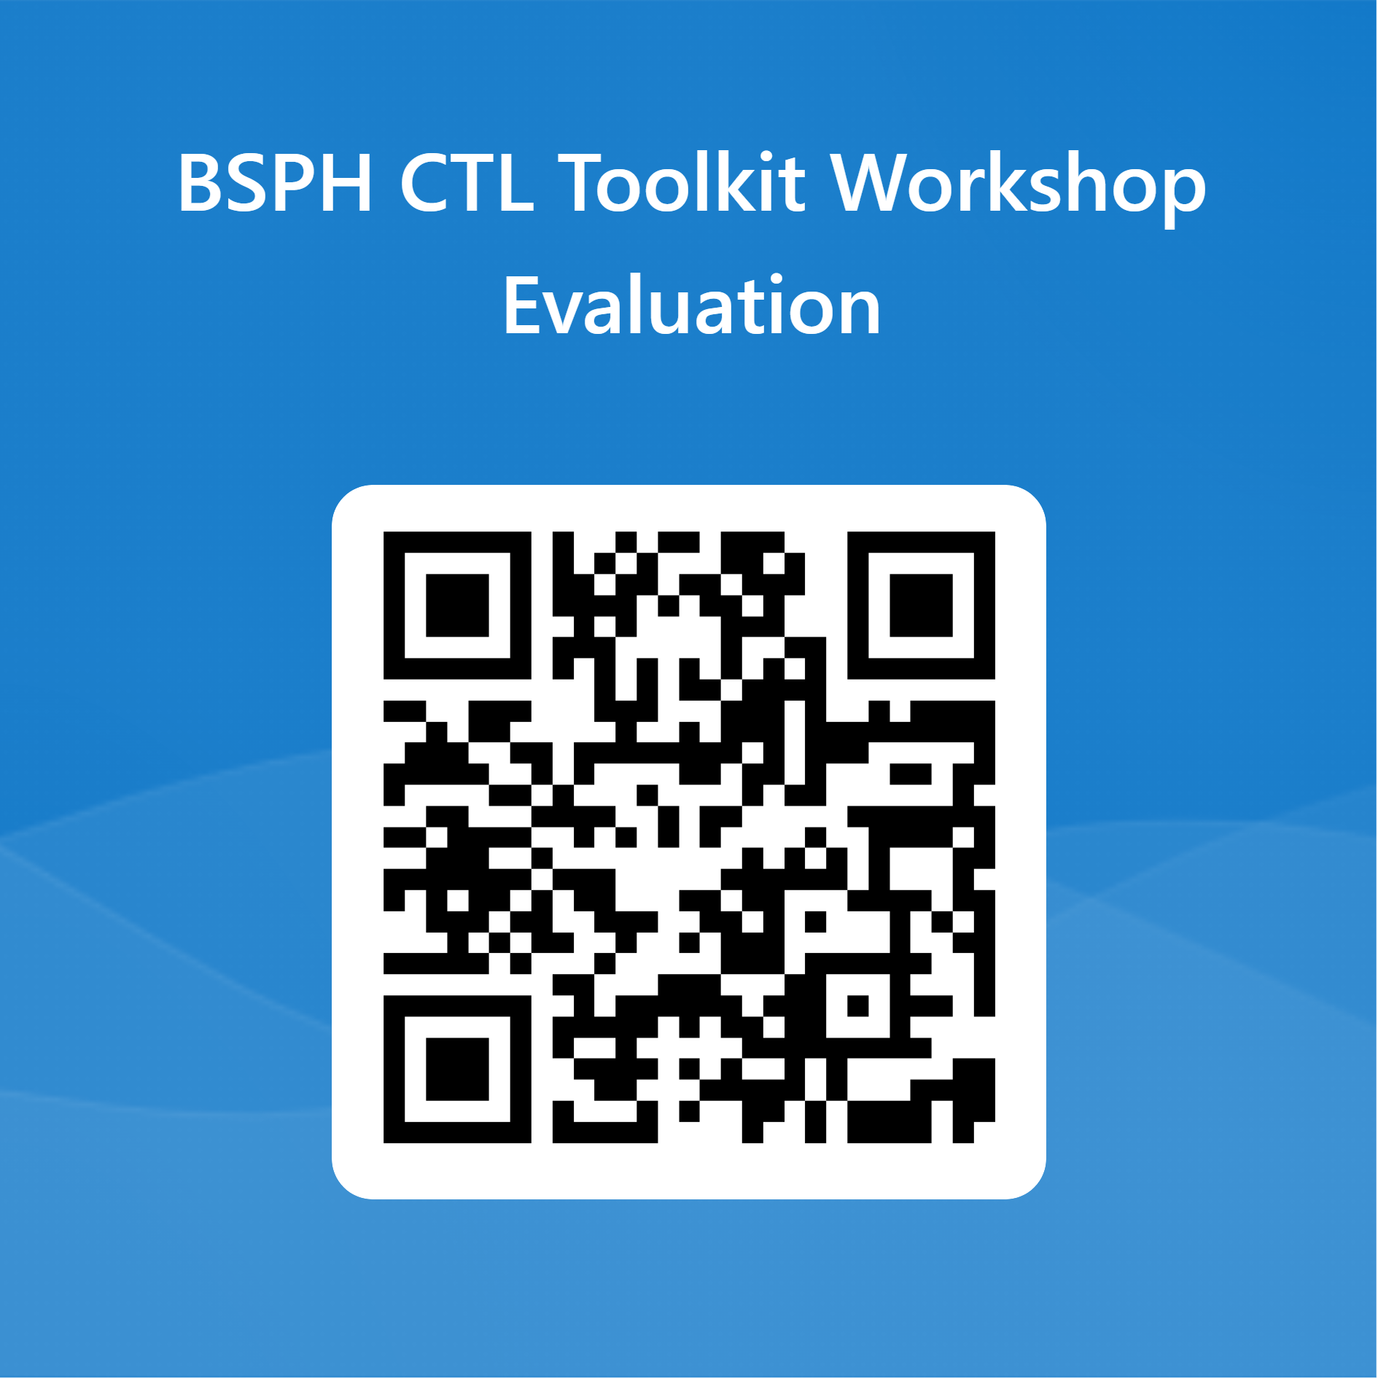
Please Give Me Your Feedback! (2 min)
https://forms.office.com/r/65fB27dUEG

