Slide 1

The Large Enrollment Course Learner: How to Create a Clear Consistent Student Experience in Complex Large Enrollment Courses
Boris Buia, PhD
Instructional Designer
JH BSPH CTL

Slide 2

Large-Enrollment Course Definition and Examples at BSPH
Definition of a large-enrollment course: can vary according to context, background and qualifications of students, and learning goals of the course.
For most STEM, health profession, and public health classes large-enrollment classes can be defined as those with a 100 all the way up to more than 500 students
Some BSPH examples of large-enrollment classes:
Biostat Methods, onsite 380, online 280
Epi Infer 1, onsite 200, online 240
Epi Methods, hybrid 240
Program Planning of Health Behavior Change, online 180
Mulryan-Kyne, 2010; image: StockCake-University lecture hall_1751983249.

Slide 3
How Comfortable Would You Be Teaching a Course With 100 or More Students? Please Select One Option
Very comfortable
Somewhat comfortable
Not very comfortable
I would rather eat frozen broccoli
You can answer in Poll Everywhere

Slide 4
What Is The Most Challenging Aspect of Teaching a Large Enrollment Course? Please Select One Option
Designing and offering a large-enrollment course
Connecting with students
Engaging students
Creating assessments
Grading and offering timely feedback
You can answer in Poll Everywhere

Slide 5

What To Do?
Edvard Munch: The Scream. Wikimedia Commons, accessed July 15, 2025. https://commons.wikimedia.org/wiki/File:Skrik_Nasjonalgalleriet_Oslo_10_2018_3930.jpg

Slide 6
Presentation Overview
Designing and offering a large-enrollment course
Connecting with students
Engaging students
Creating assessments
Grading and offering timely feedback

Slide 7
Designing and Offering a Large Enrollment Class

Slide 8
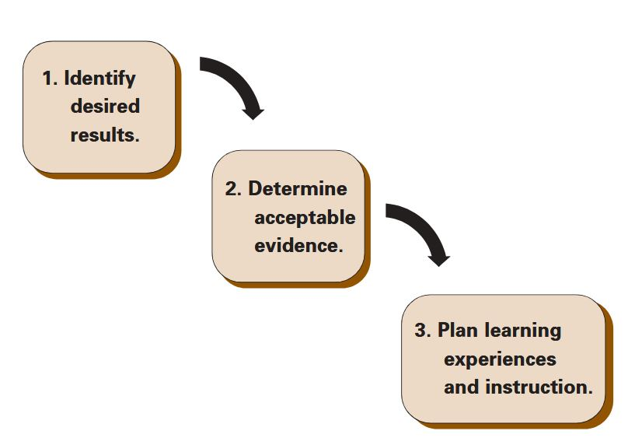
Course Design - Three Stages of Backward Design
1. Identify desired results
Course learning outcomes
2. Determine acceptable evidence
Summative assessments
3. Plan learning experiences and instruction
Modules/lectures/sessions /LiveTalks
Module/lecture learning outcomes
Readings, labs, other materials
Formative assessments
G. Wiggins and J. McTighe, 2001.

Slide 9
Syllabus and Schedule
CoursePlus Syllabus
Operational roadmap
“Source of cultural capital” that serves to equalize the information that students from different backgrounds have access to
Course resources
Support services (Students health and well being; Accommodations and Accessibility; Tutoring; Office Hours)
Low stake quiz or survey to encourage students to get familiar with key aspects of the syllabus
CoursePlus Schedule
Complete schedule before start of class
By week or module
Consistent titles
Practice quizzes and exams
High stake assessments
Labs
Due dates
Dean, K. L. and S. Wright 2017; Gin et al. 2021.

Slide 10
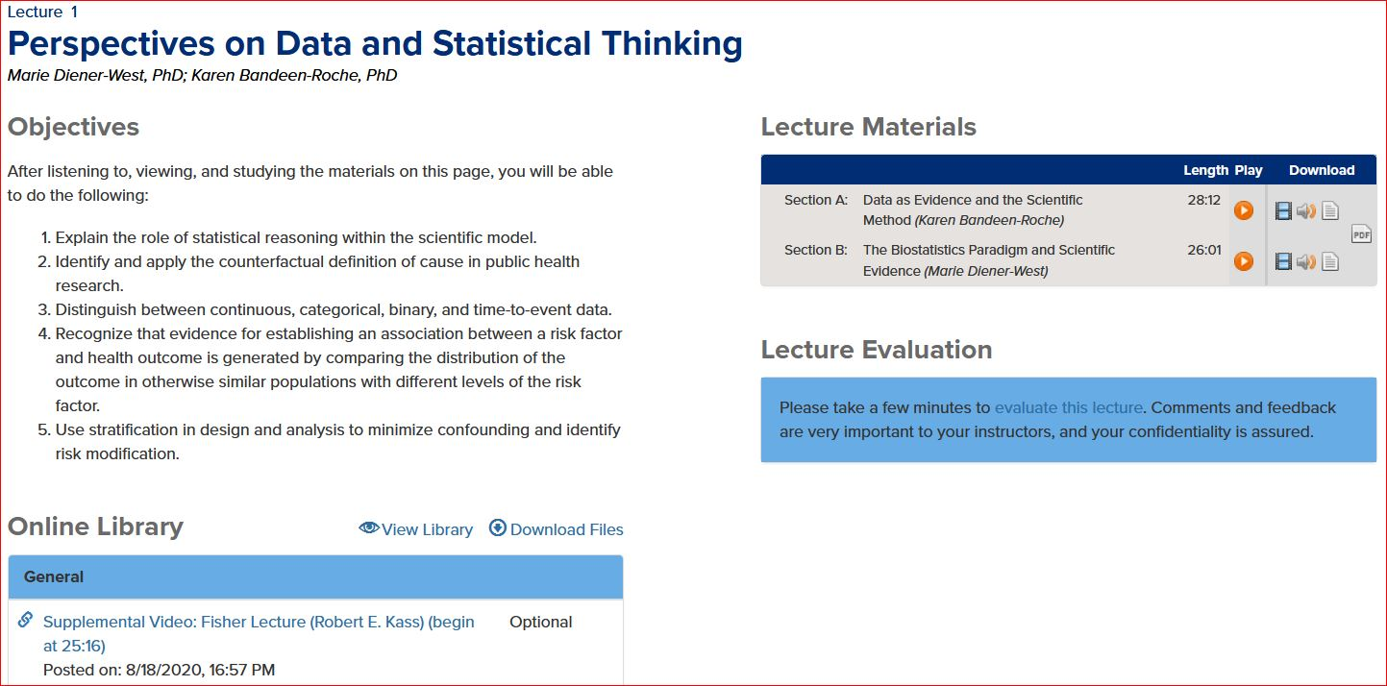
CoursePlus Course Pages
Course Pages
Lectures and Sessions
Consistent layout
Learning objectives
Resources
Guest speakers
Assessments
Map to learning objectives
Up-to-date guidelines
Up-to-date resources
Logistics

Slide 11
Teaching Team Communication and Coordination
Dedicated channel of communication
Meetings and touch points
Onboarding guidelines for new members
How to address high stakes situations
Who does what when
Consistency
Use of technical terminology
Explanation of complex topics
High stake assessments
Guidelines
Which questions to answer and which questions not to answer
When to stop answering questions before a high stakes assessment
Grading and grade norming

Slide 12
Connecting with Students

Slide 13
Impersonal Atmosphere
Space
Large lecture hall with hundreds of students and instructors on stage
Increase in noise and distractions
Interaction
Lack of interaction with faculty members and TAs (in and out of class)
Lack of or insufficient student-to-student interaction
Lessened individual accountability
Irregular attendance
Assessments
Lack of frequent testing
Slow feedback
Bonwell CC, Eison JA 1991; Cooper, J. L., & Robinson, P. 2000; Kuh, G., Schuh, J. H., and Whitt, E. J. 1991.

Slide 14
Get to Know Your Students
Course welcome session to:
Introduce the teaching team
Offer a course tour
Surveys
Questions are not personal, not required
Answers are shared only with TAs
CoursePlus Roster
Name, Program, Pronouns, Location
Invite students to introduce themselves
Know and use their names
“College students who reported a greater sense of belonging at the university were doing better academically, felt more competent scholastically, had higher self-worth”*
Cooper, K. M., B. Haney, A. Krieg, and S. E. Brownell 2016; Pittman, L. D., & Richmond, A. 2007*.

Slide 15
Communicate Often
Communicate with empathy early and often
Regular communications
Course emails
Weekly emails to the entire class
Emails to specific groups/subgroups
Emails to individual students
Make time for students’ questions during sessions and LiveTalks
Discussion Forum
Podcast
Dart, S., and B. Spratt 2021.

Slide 16
Engaging students

Slide 17
Traditional Lecturing and Passive Learning
Assumptions:
All students possess the prerequisite knowledge to benefit from the lecture
All students need the same information presented orally at the same time and pace, without dialogue with the presenter
All students have high working-memory capacities
All students have good note-taking skills
Possible consequences:
Passive learning
Difficulty paying attention
Inconsistent note taking
Low retention of course content
Cooper, J. L., & Robinson, P. 2000; Gardiner, L. F. 1994.

Slide 18
Active Learning Makes a Difference
“Active learning engages students in the process of learning through activities and/or discussion in class, as opposed to passively listening to an expert. It emphasizes higher-order thinking and often involves group work.”
Metanalysis of 225 studies on examination scores and failure rates when comparing student performance in undergraduate STEM courses with traditional lecturing versus active learning sections
Results:
Average examination scores improved by about 6% in active learning sections
Students in classes with traditional lecturing were 1.5 times more likely to fail than were students in classes with active learning
Freeman, Scott et al. 2014.

Slide 19
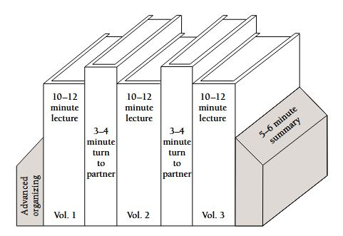
Engaging Students: Synchronous Sessions and LiveTalks
Session and LiveTalk chunking (15-20 minutes)
“Chunking the delivery of content isn’t about catering for ‘weak generational attention span’, it’s to maximise learning efficiency.”*
Engagement during sessions / LiveTalks
Model problem solving
Elicit students’ questions
Think, pair share
Polling (muddiest point)
Structured group learning (lab)
Sweller, J. 1988; Sweller, J., Van Merriënboer, J. J. G., & Paas, F. 2019; Moss, P. G. 2023*; Arshad, N. 2009; Dart, S. 2022; Nadile et al. 2021; Dean, K. L. and S. Wright 2017; Allen, D. & Tanner, K. 2005; Deslauriers, Lois. 2011; Rosenshine, B. V., and Meister, C. 1995. Image: Smith, K.A. 2000.

Slide 20
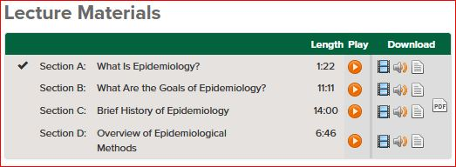
Engaging Students: Asynchronous Online Lectures
Lecture, session chunking
Section (15-20 minutes)
Engagement during the lectures
Model problem-solving
Formative quizzes
Structured group learning (lab)
Discussion Forum
Muddiest point
Sweller, J. 1988; Sweller, J., Van Merriënboer, J. J. G., & Paas, F. 2019; Arshad, N. 2009; Dart, S. 2022; Nadile et al. 2021; Dean, K. L. and S. Wright 2017; Allen, D. & Tanner, K. 2005; Rosenshine, B. V., and Meister, C. 1995.

Slide 21
Small Groups - Labs
Small groups:
Promote cognitive elaboration
Enhance critical thinking
Foster a social community of learners that taps higher-order thinking and promotes social and emotional development
To improve the quality of small-group work:
Provide explicit instructions and time frame
Ask students to assume roles: time-keeper, note taker, speak person
Ask groups to share learning outcomes
Cooper, J. L., & Robinson, P. 2000; Smith, K.A. 2000; Allen, D. & Tanner, K. 2005; Bonwell CC, Eison JA 1991; Dean, K. L. and S. Wright 2017.

Slide 22
Creating Assessments

Slide 23
Formative and Summative Assessment Comparison
Formative Assessment:
“Assessment for learning
Improves learning
Takes place while learning is in progress
Focused on learning process and progress”
Can be collaborative or student regulated
Provides feedback on learning progress to students and faculty
Summative Assessment:
“Assessment of learning
Measures learning attainment
Takes place at the end of learning
Focused on learning products
Instructor directed
May be final evaluation”
“Office of Curriculum, Assessment and Teaching Transformation .” University of Buffalo. Accessed July 15, 2025. https://www.buffalo.edu/catt/teach/develop/evaluate/evaluating-course-design.html

Slide 24
Formative Assessment Examples
Examples of Formative Assessments
Think, pair share
Polling
Muddiest point
Discussion forum posts
Reflection papers
Worksheets
Homework
Quizzes
Practice exams
Typically “low-stakes” graded or ungraded assessments.
Can be used to create connection between faculty and students, build student-to-student community, in addition to reinforcing learning.
Should align with module and/or lecture learning objectives and offer feedback to both students and faculty about the learning taking place.
Homework: a positive correlation between homework and exam performance can be drawn, particularly for lower aptitude learners.
Office of Curriculum, Assessment and Teaching Transformation, University at Buffalo; Rieger et al, 2015.

Slide 25

Formative Assessments – Quizzes & Practice Exams 1
“The testing effect”: repeated testing leads to greater memory retention of material than repeated study alone.
Practice exams should mirror graded exams to increase students’ confidence and familiarity with the exam.
Online, multiple-choice quizzes and practice exams with automated grading provide students with instantaneous feedback regarding their performance, empowering them to become “self-regulated learners.”
Self-regulated learners: “generate internal feedback as they monitor their engagement with learning activities and tasks and assess progress toward their goals.”*
Lubrick, 2022; Roediger & Karpick, 2006; Jacoby et al, 2014; Nicol, D. J., & Macfarlane‐Dick, D., 2006*; Sadler, 1989; Image: https://stockcake.com/i/students-using-laptops_1339782_206028

Slide 26
Formative Assessments – Quizzes & Practice Exams 2
Provide a table with quizzes and practice tests that directs students to the relevant learning material for a given question, further facilitating self-regulated learning.
Create multiple questions addressing similar topics.
Align questions with lecture and/or course learning objectives.
To avoid pitfalls and confusion, use guidelines to draft multiple choice and short answer questions.
Multiple questions aligned with LOs
Formative assessments
Summative assessments (exams)
Practice exams
Self-regulated learning
Beerepoot, 2023; Haladyna 2002; Towns 2014; Stevens et al, 2025; Image: Adapted from Beerepoot 2023.

Slide 27
Summative Assessments – Examples
Examples of Summative Assessments in Large Enrollment Classes
Exams
Research & constrained research experiences
Projects
Presentations
E-portfolios
Typically “high stakes” graded assessments.
Given the ease of automated scoring, minimization of grading bias and strong assessment validity exams are a common summative assessment, especially in large-enrollment classes.
Vasudevan, 2021; Butler & Roediger, 2008; Gottlieb, 2022; Oc & Hassen, 2025.

Slide 28
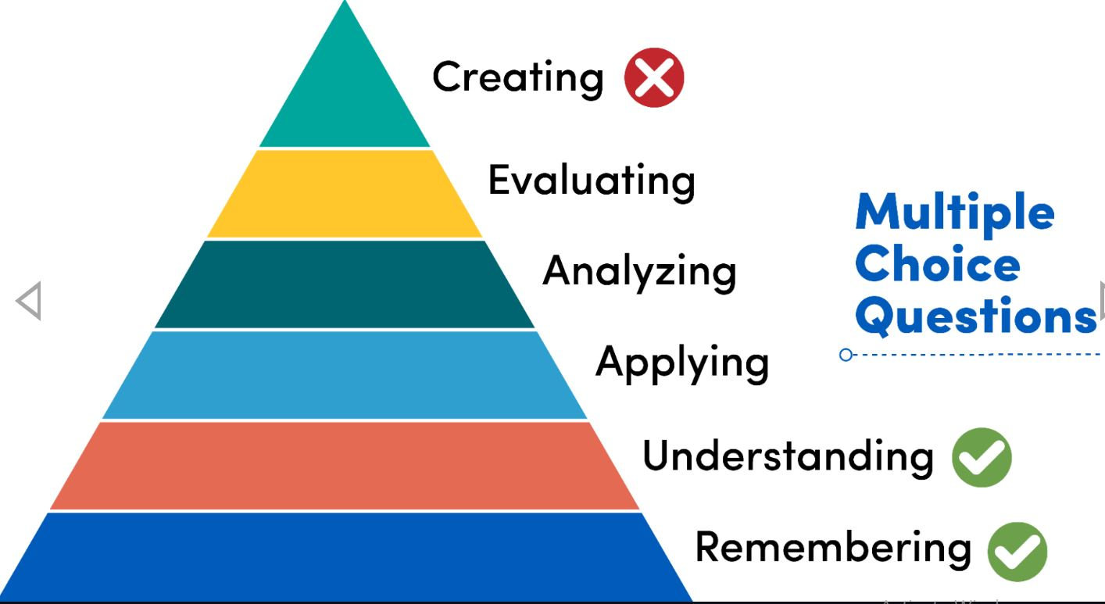
Summative Assessments – Exams
Lower-level learning: Multiple choice and other types of questions can be used for the lower-level skills of “remembering” and “understanding.”
Higher-level learning: research also offers guidelines for designing multiple choice questions that assess higher level thinking skills such as applying, analyzing and evaluating. Two approaches include:
Stacking: “stacking” within a single question requires “application of more concepts, skills, decisions or steps.”
Data sets & question blocks
Image based on Anderson, L. W. and Krathwohl, D. R., et al (Eds..) 2001 A Taxonomy for Learning, Teaching, and Assessing: A Revision of Bloom’s Taxonomy of Educational Objectives. Allyn & Bacon. Boston, MA (Pearson Education Group). Image source: “Office of Curriculum, Assessment and Teaching Transformation .” University of Buffalo. Accessed July 15, 2025. https://www.buffalo.edu/catt/teach/develop/evaluate/evaluating-course-design.html Scully, 2017; Stevens et al, 2022.

Slide 29

Summative Assessments – Additional Considerations
High-stake exams—additional considerations:
Communicate clearly
Dates and times
Time boxed or not
Open book or closed book; resources and tools allowed
Randomization
Avoid scheduling conflicts with other exams by using the School’s large-enrollment class exam calendar
Image: https://www.publicdomainpictures.net/en/view-image.php?image=37529&picture=calendar-icons-clipart

Slide 30
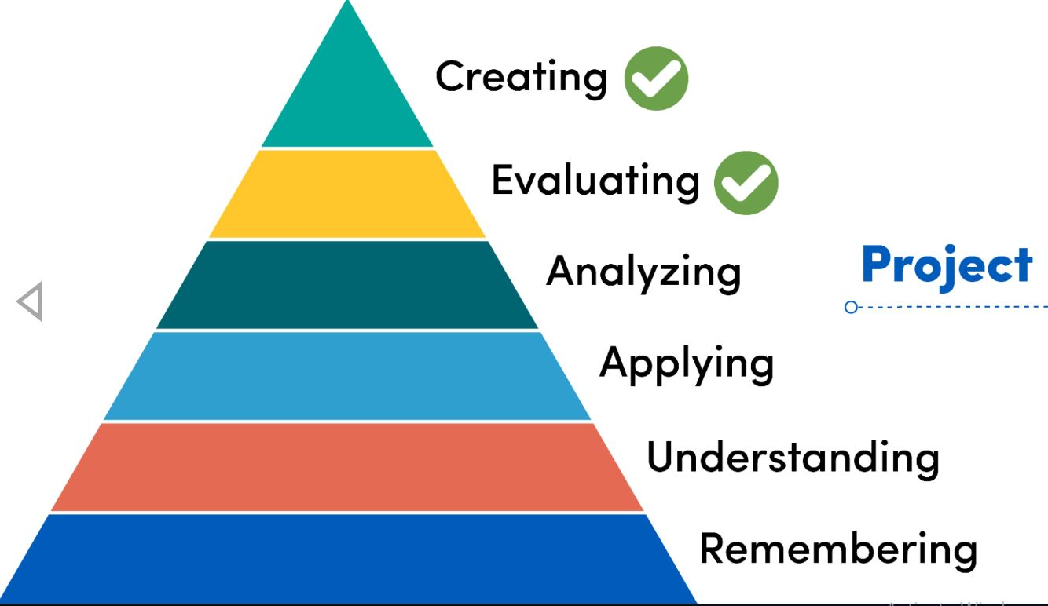
Summative Assessments – Projects
Open-ended assessments: research and other projects allow students to meet the highest level thinking skills, but can present resource challenges in large-enrollment classes. The following strategies can assist with successful implementation:
Scaffolding
Guidelines and timelines
Rubrics
Examples of good assessments
In preparation for the assessment, hold a LiveTalk or session to explain pitfalls to avoid and address questions.
Image based on Anderson, L. W. and Krathwohl, D. R., et al (Eds..) 2001 A Taxonomy for Learning, Teaching, and Assessing: A Revision of Bloom’s Taxonomy of Educational Objectives. Allyn & Bacon. Boston, MA (Pearson Education Group). Source: “Office of Curriculum, Assessment and Teaching Transformation .” University of Buffalo., University at Buffalo, Accessed July 15, 2025. https://www.buffalo.edu/catt/teach/develop/evaluate/evaluating-course-design.html

Slide 31
Grading and Offering Timely Feedback

Slide 32
Grading and Feedback 1
For students to be successful, they need to receive three key pieces of feedback:
1. “What good performance is
2. How current performance relates to good performance
3. What to do to close the gap between current and good performance”
Grading rubrics
Shared with students prior to assessments, offer students a roadmap to success
Shared with students after assessments, identify a student’s performance in relation to good performance
Can empower students to “close the gap” as self-regulated learners
Streamline the grading process and render it more objective and consistent
Sadler, 1989; Nicol , 2006.

Slide 33
Grading and Feedback 2
Grading and grade norming
Two steps
Meeting one: to illustrate use of rubric and feedback
Meeting two: evaluate new teaching members’ implementation of rubric and feedback
After the assessment
Timely turnaround of graded assessments
Give time to students to process the feedback before the next assessment
LiveTalk or session to review assessments
Share data on grade distribution
Offer 1 on 1 support (office hours)

Slide 34
References - 1
Allen, Deborah and Kimberly Tanner. 2005. "Infusing Active Learning into the Large-Enrollment Biology Class: Seven Strategies, from the Simple to Complex." Cell Biology Education 4 (4): 262–268. doi:10.1187/cbe.05-08-0113.
Arshad, Naveed. 2009. "Teaching Programming and Problem Solving to CS2 Students using Think-Alouds."ACM, . doi:10.1145/1508865.1508998.
Beerepoot, Maarten T. P. 2023. "Formative and Summative Automated Assessment with Multiple-Choice Question Banks." Journal of Chemical Education 100 (8): 2947–2955. doi:10.1021/acs.jchemed.3c00120.
Bonwell, Charles C. and James A. Eison. 1991. Active Learning: Creating Excitement in the Classroom. 1991 ASHE-ERIC Higher Education Reports. https://eric.ed.gov/?id=ED336049.
Butler, Andrew C. and Henry L. Roediger. 2008. "Feedback Enhances the Positive Effects and Reduces the Negative Effects of Multiple-Choice Testing." Memory & Cognition 36 (3): 604–616. doi:10.3758/MC.36.3.604.

Slide 35
References - 2
Cooper, James L. and Pamela Robinson. 2000a. "The Argument for Making Large Classes seem Small." New Directions for Teaching and Learning 2000 (81): 5–16. doi:10.1002/tl.8101.
———. 2000b. "The Argument for Making Large Classes seem Small." New Directions for Teaching and Learning 2000 (81): 5–16. doi:10.1002/tl.8101.
Cooper, Katelyn M., Brian Haney, Anna Krieg, and Sara E. Brownell. 2017. "What’s in a Name? the Importance of Students Perceiving that an Instructor Knows their Names in a High-Enrollment Biology Classroom." CBE Life Sciences Education 16 (1): ar8. doi:10.1187/cbe.16-08-0265.
Dart, Sarah. 2022. "Evaluating the Impact of Worked Example Videos for Blended Learning in a Large-Enrolment Business Statistics Course." Statistics Education Research Journal 21 (1): 8. doi:10.52041/serj.v21i1.93.
Dean, Kathy Lund and Sarah Wright. 2017. "Embedding Engaged Learning in High Enrollment Lecture-Based Classes." Higher Education 74 (4): 651–668. doi:10.1007/s10734-016-0070-4.

Slide 36
References - 3
Deslauriers, Louis, Ellen Schelew, and Carl Wieman. 2011. "Improved Learning in a Large-Enrollment Physics Class." Science (American Association for the Advancement of Science) 332 (6031): 862–864. doi:10.1126/science.1201783.
Freeman, Scott, Sarah L. Eddy, Miles McDonough, Michelle K. Smith, Nnadozie Okoroafor, Hannah Jordt, and Mary Pat Wenderoth. 2014. "Active Learning Increases Student Performance in Science, Engineering, and Mathematics." Proceedings of the National Academy of Sciences - PNAS 111 (23): 8410–8415. doi:10.1073/pnas.1319030111.
Gin, Logan E., Rachel A. Scott, Leilani D. Pfeiffer, Yi Zheng, Katelyn M. Cooper, and Sara E. Brownell. 2021. "It’s in the Syllabus … Or is it? how Biology Syllabi can Serve as Communication Tools for Creating Inclusive Classrooms at a Large-Enrollment Research Institution." Advances in Physiology Education 45 (2): 224–240. doi:10.1152/advan.00119.2020.
Gottlieb, Michael, John Bailitz, Megan Fix, Eric Shappell, and Mary Jo Wagner. 2023. "Educator's Blueprint: A How‐to Guide for Developing High‐quality Multiple‐choice Questions." AEM Education and Training 7 (1): e10836–n/a. doi:10.1002/aet2.10836.
Haladyna, Thomas M., Steven M. Downing, and Michael C. Rodriguez. 2002. "A Review of Multiple-Choice Item-Writing Guidelines for Classroom Assessment." Applied Measurement in Education 15 (3): 309–333. doi:10.1207/S15324818AME1503_5.

Slide 37
References - 4
Jacoby, Jennifer,C., Sheelagh Heugh, Christopher Bax, and Christopher Branford-White. 2014. "Enhancing Learning through Formative Assessment." Innovations in Education and Teaching International 51 (1): 72–83. doi:10.1080/14703297.2013.771970.
Kuh, George D., John H. Schuh, and Elizabeth J. Whitt. 1991. "Diversity & Community: Some Good News about Campus Life: How "Involving Colleges" Promote Learning Outside the Classroom." Change (New Rochelle, N.Y.) 23 (5): 48–55.
Moss, Paul G. 2023. “Chunking as a Pedagogy.” Learning Design by Paul G. Moss. February 13, 2023. Accessed July 15, 2025. https://paulgmoss.com/2023/02/13/chunking-as-a-pedagogy/
Nadile, Erika M., Emilie Alfonso, Briana Michelle Barreiros, William Bevan-Thomas, Sara E. Brownell, Megan R. Chin, Isabella Ferreira, et al. 2021. "Call on Me! Undergraduates’ Perceptions of Voluntarily Asking and Answering Questions in Front of Large-Enrollment Science Classes." PloS One 16 (1): e0243731. doi:10.1371/journal.pone.0243731.
Nicol, David J. and Debra Macfarlane-Dick. 2006. "Formative Assessment and Self-Regulated Learning: A Model and Seven Principles of Good Feedback Practice." Studies in Higher Education (Dorchester-on-Thames) 31 (2): 199–218. doi:10.1080/03075070600572090.
Oc, Yusuf and Hela Hassen. 2025. "Comparing the Effectiveness of Multiple-Answer and Single-Answer Multiple-Choice Questions in Assessing Student Learning." Marketing Education Review 35 (1): 44–57. doi:10.1080/10528008.2024.2417106.

Slide 38
References - 5
Office of Curriculum, Assessment and Teaching Transformation .” University of Buffalo., University at Buffalo, Accessed July 15, 2025. https://www.buffalo.edu/catt/teach/develop/evaluate/evaluating-course-design.html
Pittman, Laura D. and Adeya Richmond. 2007. "Academic and Psychological Functioning in Late Adolescence: The Importance of School Belonging." The Journal of Experimental Education 75 (4): 270–290. doi:10.3200/JEXE.75.4.270-292.
Roediger, Henry L. and Jeffrey D. Karpicke. 2006. "The Power of Testing Memory: Basic Research and Implications for Educational Practice." Perspectives on Psychological Science 1 (3): 181–210. doi:10.1111/j.1745-6916.2006.00012.x.
Rosenshine, Barak and Carla Meister. 1992. "The use of Scaffolds for Teaching Higher-Level Cognitive Strategies." Educational Leadership 49 (7): 26.
Sadler, D. Royce. 1989. "Formative Assessment and the Design of Instructional Systems." Instructional Science 18 (2): 119–144. doi:10.1007/BF00117714.

Slide 39
References - 6
Smith, Karl A. 2000. "Going Deeper: Formal Small-Group Learning in Large Classes." New Directions for Teaching and Learning 2000 (81): 25–46. doi:10.1002/tl.8103.
Stevens, Scott P., Susan W. Palocsay, and Luis J. Novoa. 2023. "Practical Guidance for Writing Multiple-Choice Test Questions in Introductory Analytics Courses." Transactions on Education 24 (1): 51–69. doi:10.1287/ited.2022.0274.
Sweller, John. 1988. "Cognitive Load during Problem Solving: Effects on Learning." Cognitive Science 12 (2): 257–285. doi:10.1016/0364-0213(88)90023-7.
Towns, Marcy H. 2014. "Guide to Developing High-Quality, Reliable, and Valid Multiple-Choice Assessments." Journal of Chemical Education 91 (9): 1426–1431. doi:10.1021/ed500076x.
Wiggins, Grant P. and Jay McTighe. 2005. Understanding by Design / Grant Wiggins and Jay McTighe. 2nd ed. Alexandria, VA: Association for Supervision and Curriculum Development.

Slide 40
CTL Resources
BSPH Syllabus Guidance [PDF]
The Developing Learner: Using Formative Assessment to Facilitate Learning and Connection [Workshop]
The Fundamentals of Multiple Choice Question Writing for Better Learning [Workshop]
Strategies for Writing Multiple Choice Items [PDF]
Rubrics: Benefits and Grading Strategies [Workshop]
Rubrics: Benefits for Faculty and Students [Blogpost]

Slide 41
Continuing Professional Development with CTL
Teaching Assistantship Training​
Workshops, On-demand Videos, and Blog​
Notes:
We would like to highlight some additional resources!​
​
CTL has a self-paced course "Essentials of Course Design, Development, and Teaching at BSPH" for faculty who want to learn more about course management, redesign, and other pedagogical topics. Link to register is in the chat. ​
​
If you are a TA or work with TAs, then we highly recommend CTL’s TA Training course.​
​
Finally, you can stay up-to-date on the latest events and recommendations from CTL by checking out our Events page and subscribing to our blog. Links are in the chat. ​
​
Thank you so much!​
​
LINKS FOR CHAT:​
Essentials: https://courseplus.jhu.edu/core/index.cfm/go/course.home/cid/2790​
Training for Faculty and TAs: https://www.ctltoolkit.com/faculty-and-tas​
CTL Events: https://www.ctltoolkit.com/events​
CTL Blog: https://ctl.jhsph.edu/blog/​

Slide 42
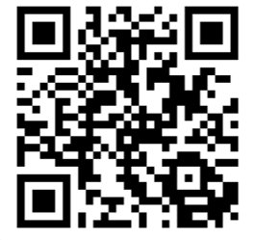
Anonymous, 2- Minute Workshop Evaluation
2025 Workshop Evaluation Form: https://forms.office.com/r/YmXFUqRCAd​

